Slide 1
REASONING IN UNCERTAIN SITUATIONS
Dr. KEERTHY A S

Slide 2
Abductive inference
Abductive reasoning typically begins with an incomplete set of observations and proceeds to the likeliest possible explanation for the set.
Abductive reasoning yields the kind of daily decision-making that does its best with the information at hand, which often is incomplete.
A medical diagnosis is an application of abductive reasoning: given this set of symptoms, what is the diagnosis that would best explain most of them?
Deductive | Inductive | Abductive
All humans are mortal (premise 1). Socrates is a human (premise 2). Therefore, Socrates is mortal (conclusion). | Every swan observed so far is white. Therefore, all swans are white. | You find your car wet in the morning. The simplest explanation is that it rained overnight.
Abduction is an unsound rule of inference, meaning that the conclusion is not necessarily true for every interpretation in which the premises are true

Slide 3
Monotonic Reasoning
Non-monotonic Reasoning
Monotonic Reasoning is the process which does not change its direction or can say that it moves in the one direction.
Monotonic Reasoning deals with very specific type of models, which has valid proofs.
The addition in knowledge won’t change the result.
In monotonic reasoning, results are always true, therefore, set of prepositions will only increase.
Monotonic Reasoning is based on true facts
Deductive Reasoning is the type of monotonic reasoning.
Non-monotonic Reasoning is the process that changes its direction or values as the knowledge base increases.
Non-monotonic reasoning deals with incomplete or not known facts.
The addition of knowledge will invalidate the previous conclusions and change the result
In non-monotonic reasoning, results and set of prepositions will increase and decrease based on the condition of added knowledge.
Non-monotonic Reasoning is based on assumptions.
Abductive Reasoning and Human Reasoning is a non-monotonic types of reasoning.

Slide 4
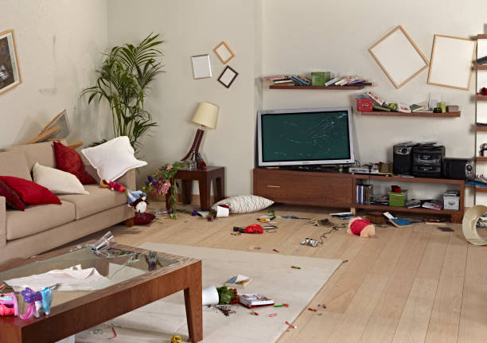

Slide 5
Logic Based Abductive Inference
Observations:
Front door ajar.
Belongings scattered.
Broken window in the living room.
Hypotheses:
Burglary: Someone broke into your house to steal valuables.
Accident: A severe storm caused the window to break, and the scattered belongings are a result of the strong winds.
Vandalism: A neighborhood teenager vandalized your property as a prank.
Animal intrusion: A stray animal, such as a raccoon, entered your home, causing the mess.
Maintenance accident: A repair person accidentally left the door open and broke the window while fixing something in your absence.
Inference:
generate hypotheses that could explain the situation & assess each hypothesis.
the burglary hypothesis as the most likely explanation
Conclusion:
Conclude that a burglary likely occurred, and you take appropriate actions such as contacting the authorities and securing your home.

Slide 6
Scenario: A patient presents with symptoms such as fever, cough, and shortness of breath.
Logic Based Abductive Inference in AI
Observations:
Fever
Cough
Shortness of breath
Knowledge Base:
Disease Database: database of diseases, their symptoms, and associated medical knowledge.
Rule Base: The system has a set of logical rules representing medical diagnostic guidelines and expert knowledge.
Hypotheses:
Pneumonia: Based on the symptoms observed, the AI system hypothesizes that the patient may have pneumonia.
Bronchitis: Another hypothesis could be bronchitis, given that it shares some symptoms with pneumonia but may have a different underlying cause.
Flu: The patient could also have influenza, as fever and cough are common symptoms of the flu.
Abductive Inference:
The AI system engages in abductive reasoning to generate hypotheses that could explain the observed symptoms.
It uses logical rules and medical knowledge from the database to evaluate each hypothesis against the observed evidence.
The system considers which hypothesis is the most plausible or best fits the observed symptoms.
Conclusion:
Based on logic-based abductive inference, the AI system may conclude that pneumonia is the most likely diagnosis, given the combination of fever, cough, and shortness of breath, which are consistent with pneumonia's symptoms.
The system can then recommend further diagnostic tests or treatments based on the inferred diagnosis.

Slide 7
Logic Based Abductive Inference
Logic-based abduction is a branch of AI that deals with the inference of hypotheses from observations.
Logics for Non-monotonic Reasoning
Truth maintenance systems
Logics based on minimum models
Set cover and logic-based abduction

Slide 8
Logics for Non-Monotonic Reasoning
Logic is non-monotonic if the truth of a proposition may change when new information (axioms) is added.
Allows statement to be retracted.
Used to formalize plausible (believable) reasoning.
Example 1:
Birds typically fly.
Tweety is a bird.
Tweety (presumably) flies.
Conclusion of the non-monotonic argument may not be correct.
Example 2:
If Tweety is a penguin, it is incorrect to conclude that Tweety flies.
All monotonic reasoning is concerned with consistency.
Inconsistency is resolved, by removing the relevant conclusion(s) derived by the default rules,
The truth value of prepositions such as “Tweety is a bird” accepts default that is normally true, such as “Birds typically fly”.
A conclusion derived was “Tweety flies”.
When an inconsistency is recognized, only the truth value of the last type is changed.

Slide 9
Logics for Non-Monotonic Reasoning
Conventional reasoning using predicate logic
all the information necessary to solve the problem must be represented
the information base must be consistent; that is, pieces of knowledge cannot contradict each other
use of inference rules, the known information grows monotonically.
Non-monotonic systems
The closed world assumption is to determine as false anything that its reasoning system cannot prove to be true
logic systems entertain alternative hypotheses like how humans use knowledge of the world to direct reasoning through alternative scenarios.
Allow the addition of new knowledge based on assumptions; assumed it to be correct and use it to infer more new knowledge.
Conclusions must sometimes be reconsidered, called defeasible; that is, new information may sometimes invalidate previous results.
Representations and search procedures that keep track of the reasoning steps of a logic system are called truth maintenance systems or TMS.
In defeasible reasoning, the TMS preserves the consistency of the knowledge base, keeping track of conclusions that might later need to be questioned.

Slide 10
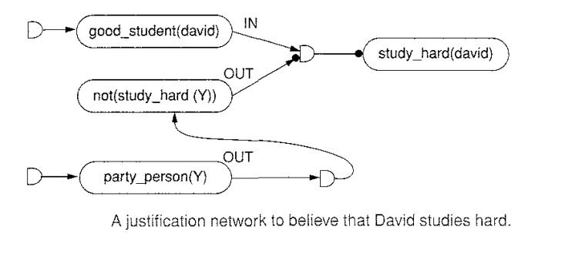
Truth Maintenance Systems
A Truth Maintenance System (TMS) is a PS module responsible for:
1.Enforcing logical relations among beliefs- Support dependency driven backtracking
Our belief ["inference-engine's belief"] about a sentence can be:
false, the sentence is believed to be unconditionally false; this is also called a contradiction
true, the sentence is believed unconditionally true; this is also called a premise
assumed-true, the sentence is assumed true [may change belief later]; this is also called an enabled assumption
assumed-false, the sentence is assumed false [may change belief later]; this is also called a retracted assumption
assumed, the sentence is believed by inference from other sentences
don't-care.
a sentence is in if true or assumed-true; it is out if false, assumed-false, or don't-care.

Slide 11
Truth Maintenance Systems
A Truth Maintenance System (TMS) is a PS module responsible for:
2.Generating explanations for conclusions.
If the advice to a stockbroker is to invest millions of dollars, an explanation of the reasons for that advice can help the broker reach a reasonable decision.
3.Finding solutions to search problems
4.Supporting default reasoning.
If Tweety is a bird, until told otherwise, we will assume that Tweety flies
5.Identifying causes for failure and recover from inconsistencies
the statement that either A, or B, or C is guilty together with the statements that A is not guilty, B is not guilty, and C is not guilty, form a contradiction.

Slide 12
Dependency Network
A TMS maintains a Dependency Network which is bipartite, with nodes representing sentences and justifications
A sentence may correspond to a fact, such as "Socrates is a man", or a rule, such as "if x is a man then x is mortal".
A justification node has inputs from sentence nodes, its premises or justifiers, and has output to a sentence node, its conclusion or justificand.
A justification node represents the inference of the conclusion from the conjunction of the stated premises.

Slide 13
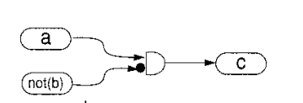
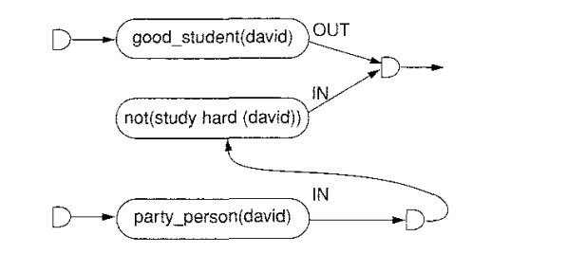

Justification-Based Truth Maintenance System (JTMS)
It is a simple TMS where one can examine the consequences of the current set of assumptions.
The meaning of sentences is not known.
A JTMS is only concerned with the dependencies among beliefs and has no concern with the contents of these beliefs

Slide 14
Assumption-Based Truth Maintenance System (ATMS)
It allows to maintain and reason with a number of simultaneous, possibly incompatible, current sets of assumption.
Otherwise it is similar to JTMS, i.e. it does not recognize the meaning of sentences.
Problem solvers need to explore multiple contexts at the same time, instead of a single one (the JTMS case)
Alternate diagnoses of a broken system
Different design choices
Competing theories to explain a set of data
Problem solvers often need to compare contexts rapidly switching from one context to another.
In JTMS, this can be done by enabling and retracting assumptions.
In ATMS, re-labeling is avoided because alternative contexts are explicitly stored.
ATMS contexts are monotonic.

Slide 15
Logical-Based Truth Maintenance System (LTMS)
Like JTMS in that it reasons with only one set of current assumptions at a time.
More powerful than JTMS in that it recognizes the propositional semantics of sentences, i.e. understands the relations between p and ~p, p and q and p&q, and so on.
Ideal for real-time propositional reasoning
Multiple belief reasoner (MBR)
Similar to the AIMS reasoner except that the problem solver and the truth maintenance
system are merged into a single system.

Slide 16
Logics Based on Minimum Models
Logics designed specifically for two situations
to reason where a set of assertions specifies only those things that are true
use the closed-world assumption
to reason where sets of conjectures arc usually true because of the nature of a problem-solving task.
circumscription
a minimum model is a model such that there are no smaller models that can satisfy the set of expressions S for all variable assignments.
The closed world assumption is based on this minimum model of the world.
predicates that are necessary for a solution are created
Circumscription requires that only those predicates relevant to the problem solving are stated.
In circumscription, axioms are added to a system that forces a minimal interpretation on the predicates of the knowledge base.
The meta-predicates describe the manner in which particular predicates are to be interpreted.
That is, they delimit, or circumscribe, the possible interpretations of predicates.
VX bird(X) Ʌ not (abnormal(X)) -> flies(X)

Slide 17
Minimum Models –Real life examples
Scenario: Suppose you are a teacher organizing a school trip for a group of students. You need to assign students to buses, ensuring that each bus has an appropriate number of students and adheres to certain constraints.
Logical Constraints:
Each bus must have at least 20 students but no more than 30 students.
Each student must be assigned to exactly one bus.
Students from the same class should be assigned to the same bus if possible.
Logic-Based Minimum Models:
Find the minimum number of buses required to transport all students while satisfying the given constraints.
The logical framework will aim to find the smallest possible set of bus assignments that meet the criteria.

Slide 18
Set Cover and Logic-Based Abduction
The set cover approach to abduction attempts to explain the act of adopting a revocable belief in some explanatory hypothesis on the grounds that it explains an otherwise unexplainable set of facts.
The logic-based approach to abduction describes inference rules for abduction along with a definition of their legitimate form(s) for use
cost-based abduction places a cost on potential hypotheses as well as a cost on rules
coherence-based selection, is particularly appealing when what is to be explained is not a simple proposition but rather a set of propositions.

Slide 19
Set Cover and Logic-Based Abduction
A city planner tasked with optimizing waste management services in a metropolitan area. Your goal is to minimize costs while ensuring that every neighborhood has access to adequate waste collection services.
Set Cover Problem:
Sets: Each neighborhood in the city represents a set that needs to be covered.
Elements: Waste collection stations represent elements that can cover multiple neighborhoods.
Objective: Find the minimum number of waste collection stations needed to cover all neighborhoods.
Logic-Based Abduction:
Observation: Distribution of households, population density, and waste generation rates in each neighborhood.
Explanation:
Hypothesis 1: Establishing waste collection stations in neighborhoods with high population density can cover the maximum number of households.
Hypothesis 2: Identifying central locations that minimize travel distance for waste collection trucks can optimize efficiency.
Hypothesis 3: Ensuring equitable distribution of waste collection stations across neighborhoods can promote social equity.
Evaluation: You evaluate each hypothesis based on logical reasoning, domain knowledge, and available data to determine the most plausible explanation.
Decision: Based on the selected explanation, you make decisions regarding the location and number of waste collection stations to achieve the desired objectives.

Slide 20
Set Cover and Logic-Based Abduction
Integration:
The Set Cover problem addresses the optimization aspect, aiming to minimize the number of waste collection stations while covering all neighborhoods.
Logic-Based Abduction helps in generating explanations and making informed decisions based on observed data and logical reasoning principles.
Outcome:
By combining Set Cover and Logic-Based Abduction, you develop an optimized waste management plan that minimizes costs, maximizes efficiency, and ensures equitable access to waste collection services across the metropolitan area.

Slide 21
Abduction: Alternatives to Logic
Humans weight conclusions with terms like highly probable, unlikely, almost certainly, or possible.
Stanford certainty theory: based on a number of observations,
Fuzzy reasoning
The Dempster-Shafer theory of evidence

Slide 22
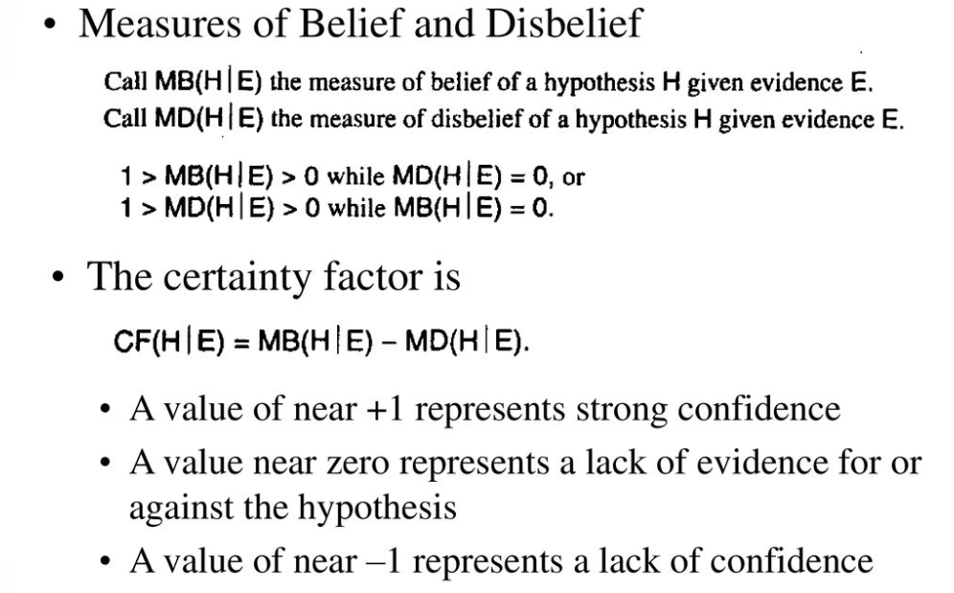
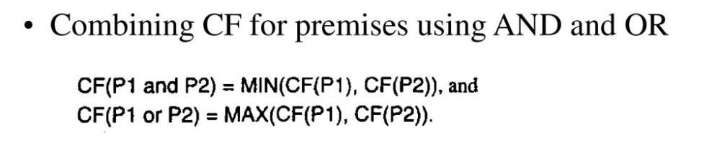
Stanford certainty theory

Slide 23
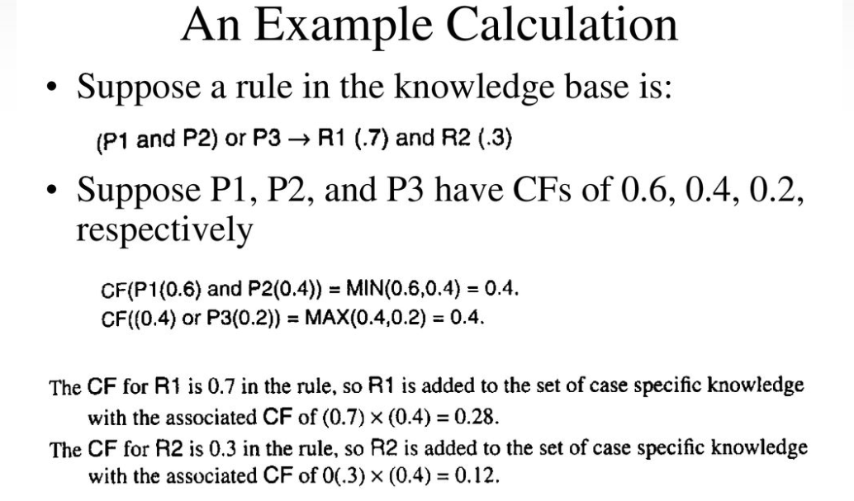

Slide 24
Reasoning with Fuzzy Sets
Fuzzy Logic (FL) is a method of reasoning that resembles human reasoning.
This approach is similar to how humans perform decision-making.
It involves all intermediate possibilities between YES and NO.
The Fuzzy logic works on the levels of possibilities of input to achieve a definite output
For example, if we say temperature, it is a linguistic variable; the values of which are very hot or cold, slightly hot or cold, very warm, slightly warm, etc.
A fuzzy subset F of S is defined by a membership function mF(s) that measures the "degree" to which s belongs to F

Slide 25
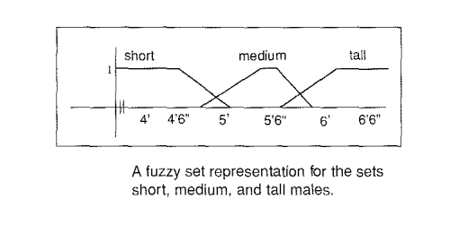
Reasoning with Fuzzy Sets
Fuzzy set theory is not concerned with how these possibility distributions are created, but rather with the rules for computing the combined possibilities over expressions that contain fuzzy variables.
Figure offers a set membership function for the concept of short, medium, and tall male humans.
Anyone person can belong to more than one set, for example, a 5' 9" male belongs to both the set of the medium as well as to the set of tall males,

Slide 26
Dempster-Shafer Theory of Evidence
Considers sets of propositions and assigns to each of them an interval [belief, plausibility] within which the degree of belief for each proposition must lie.
This belief measure, denoted bel, ranges from zero, indicating no evidence of support for a set of propositions, to one, denoting certainty.
The plausibility of a proposition p, pl(p), is defined as:
pl(p) = 1 – bel(not(p))
Dempster and Shafer address the problem of measuring certainty by making a fundamental distinction between lack of certainty and ignorance.

Slide 27
Dempster-Shafer Theory of Evidence

Slide 29
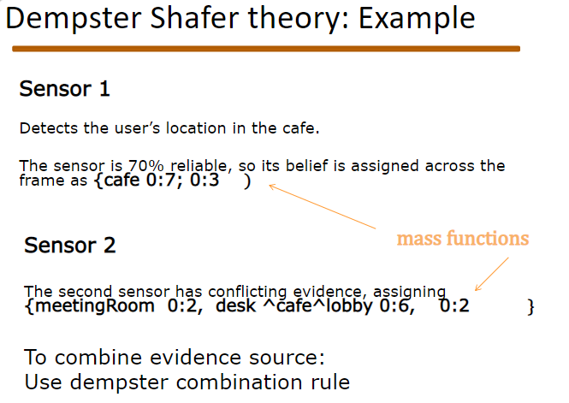

Slide 30
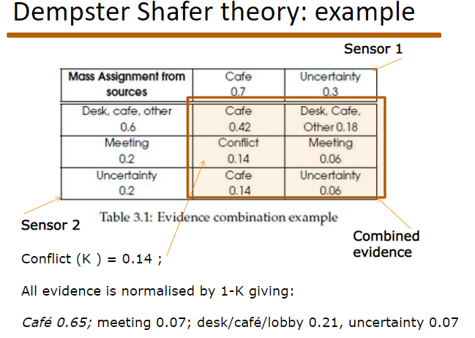

Slide 31
